Slide 1
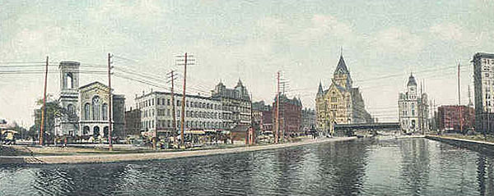
The Erie Canal

Slide 2
Hypothesis
How did building a waterway through New York State change the course of U.S. history?

Slide 3
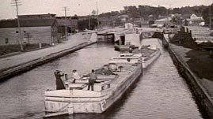
Traveling in the 1800s
Today you can talk to people or send them something electronically whether they're close by or far away. Trucks, trains, and jets can transport—move—products across the country and the world in hours or days. But things were very different in the early 1800s.
Back then, the latest development in transportation was the Erie Canal. This canal—a waterway made for travel—changed the future of the United States of America. In this lesson, we're going to look at the major changes brought about by the construction of the Erie Canal.

Slide 4
In this activity…
Goals Here is the big idea you will learn about in this lesson:
The construction of the Erie Canal affected the lives of many people in New York City, New York State, and the entire United States
Strategies You will be using many reading and writing strategies to complete this lesson. The key strategies that you will focus on are:
Categorizing basic facts and ideas
Establishing cause and effect
Determining important information
Vocabulary Read these words and their definitions.
Canal- a human made waterway for boats to travel from one body of water to another
Commercial- something that involves the buying or selling of goods
Construction- the act or process of building or making something
Transport- to move, often over a great distance

Slide 5
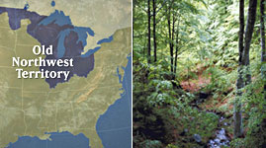
Traveling the Northwest Territory
When the United States was young, most people lived on the East Coast. As the population grew, people needed more land and supplies. The Northwest Territory, an area of land around the Great Lakes, had open space and rich farmland. It also had natural resources such as timber (trees used for building), minerals, and animal furs.
However, traveling between the East and the Northwest Territory was not easy. The route was long, and it passed through the Appalachian Mountains. This was a time before highways, cars, and trains. People had to travel on small roads and rivers, and it took weeks to make the dangerous trip.
Write down two reasons people from the East Coast would move to the Northwest Territory.

Slide 6
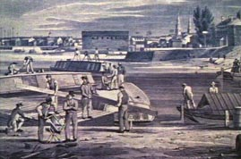
Constructing the Erie Canal
In 1808, New York's governor, DeWitt Clinton, believed that building a canal through the state would create a better way to reach the Northwest Territory. This canal would allow boats to travel from the Great Lakes to New York City. There, goods—products to be bought and sold—could be loaded onto ships that carried them to countries across the oceans. He believed that this would make New York a commercial center for the world.
Nothing like this had been done before, and some people didn't think it was possible. The canal project was nicknamed "Clinton's Big Ditch." Clinton had to fight hard to get money for the job, but he was successful. Construction began in 1817.

Slide 7
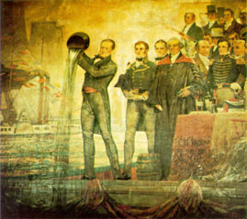
The Erie Canal is Complete!
Just eight years after construction began, workers completed the canal early and on budget. It measured an amazing 363 miles long. It was 40 feet wide and had a path (called a towpath) for horses and mules to walk along as they pulled the barges. In 1825, Governor DeWitt Clinton sailed the length of the Erie Canal to open it officially.
What was Governor Clinton's role in the completion of the Erie Canal? Give two examples.

Slide 8
The Effects of the Erie Canal Video
Transportation on the canal began immediately. As more people moved to the West, the supplies they needed arrived more quickly. Also, goods and other resources from the West were transported to markets in New York City more easily. The Erie Canal was a commercial success.
Go to http://www.pbslearningmedia.org/asset/midlit10_vid_splerie/ to view video

Slide 9
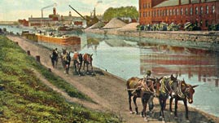
The Effects of the Erie Canal Reading
The Erie Canal affected the lives of people in both New York State and the entire nation. Read this passage to learn more about the effects of the canal.
Read the passage attached to your question packet.
After you have finished reading the passage, list three ways in which the canal changed people's lives.

Slide 10
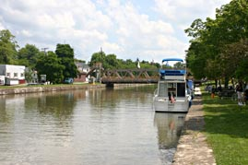
Concluding Activity
As you saw and read on the previous screens, the Erie Canal changed life for people in several regions of the country. In this activity, you will sort information on a concept map according to how each of three regions was affected by the construction of the Erie Canal. You may want to watch the video again or review the passage before doing the activity.

